Slide 1
Bank Transactions Data
VEKARIYA URVISH BHAVINBHAI ( U01995336 )
KAKADIYA KRUNAL GORDHANBHAI ( U01996544 )
DINESHGOPI SUNKARA ( U01936521 )
BHOOKYA GOPI KRISHNA ( U01936635 )

Slide 2
Objective
Analysing bank transaction data, creating machine learning models for regression or classification, and gaining insights through visualization are the objectives of this code.
For classification: Predict the transaction type (e.g., Debit or Credit).
For regression: Predict the transaction amount.

Slide 3
Data Preprocessing
Data Loading: A Pandas DataFrame is loaded with the dataset.
Managing Missing Values: To ensure that there are no gaps in the dataset and to maintain time order, missing values are filled using the forward-fill method (method='ffill’).
Data Type Conversion: For time-based analysis, the TransactionDate column is transformed into a datetime object.
Outlier Removal: The first and 99th percentiles are used to eliminate transactions with extreme quantities (top and bottom 1 percent).

Slide 4
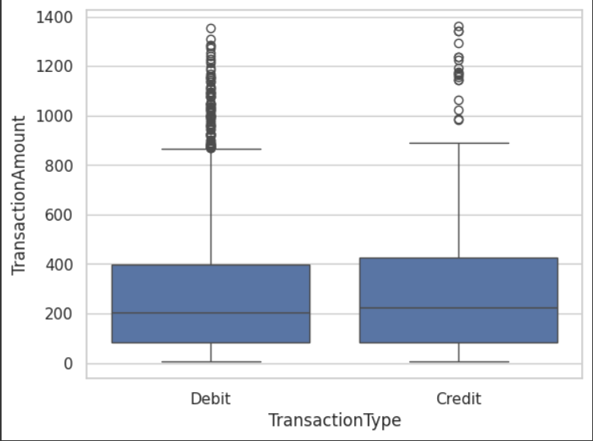
Data Visualization
Boxplot
Visualizes the distribution of transaction amounts by transaction type.
Identifies potential outliers or skewness in different categories.

Slide 5
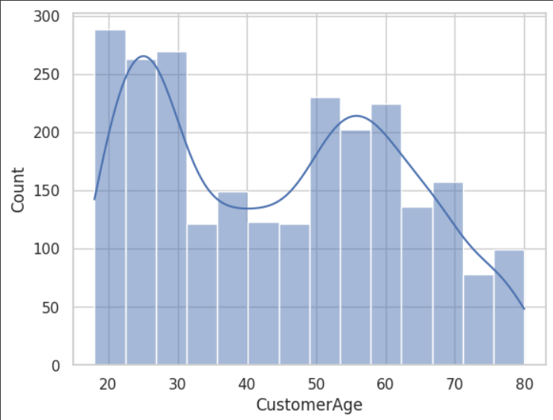
Histogram:
Displays the distribution of customer ages, giving insights into customer demographics.
Most customers are aged 20–30, with another peak at 50–60.
A decline is seen between ages 35–45 and after 60.
KDE line highlights overall trends.

Slide 6
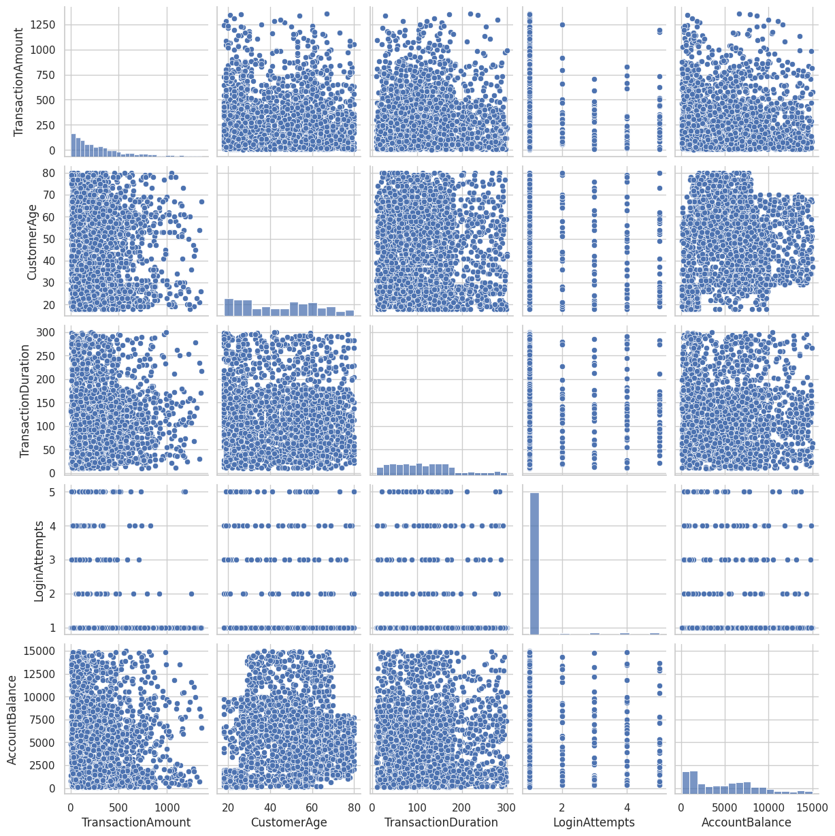
Pairplot:
Examines relationships between numerical variables using pairwise scatterplots.
Shows relationships between variables like TransactionAmount, CustomerAge, and AccountBalance.
Diagonal histograms display individual variable distributions.
Weak correlations observed between most variables.

Slide 7
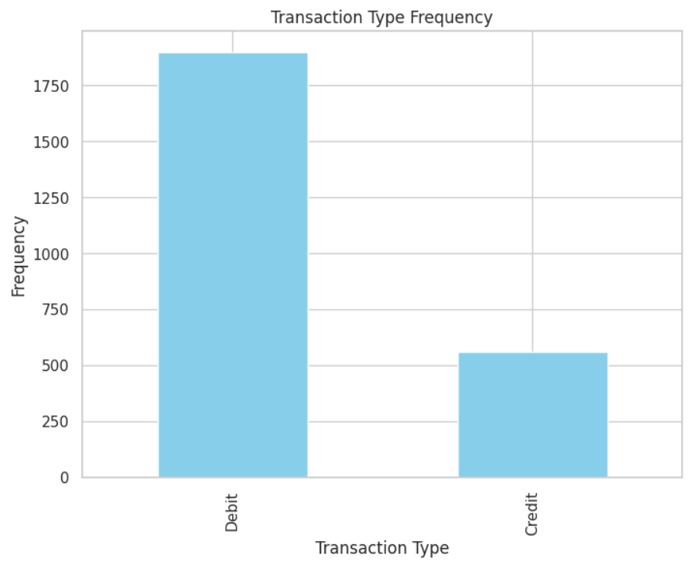
Bar Chart:
Shows the frequency of different transaction types.
Debit transactions are the most frequent, with a count of around 1750.
Credit transactions are less common, totaling approximately 500.

Slide 8
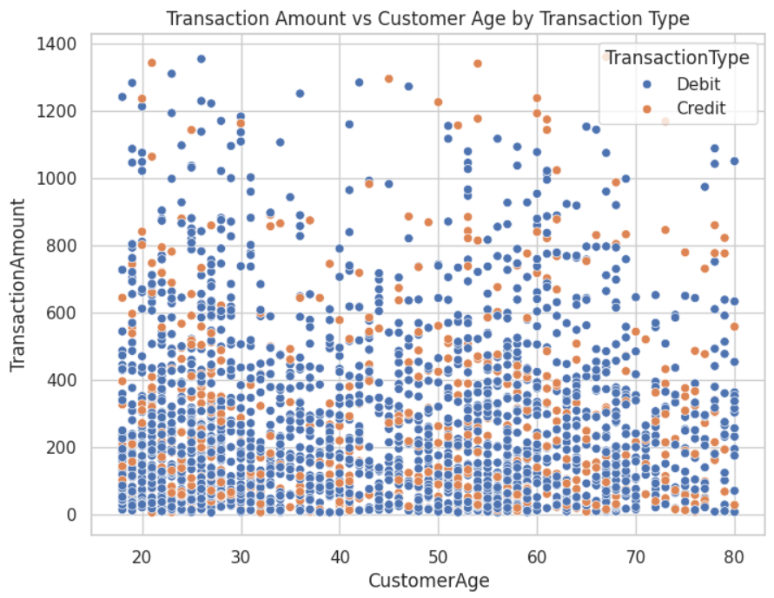
Scatter Plot:
Analyzes the relationship between customer age and transaction amount, with transaction type as a differentiating factor.

Slide 9
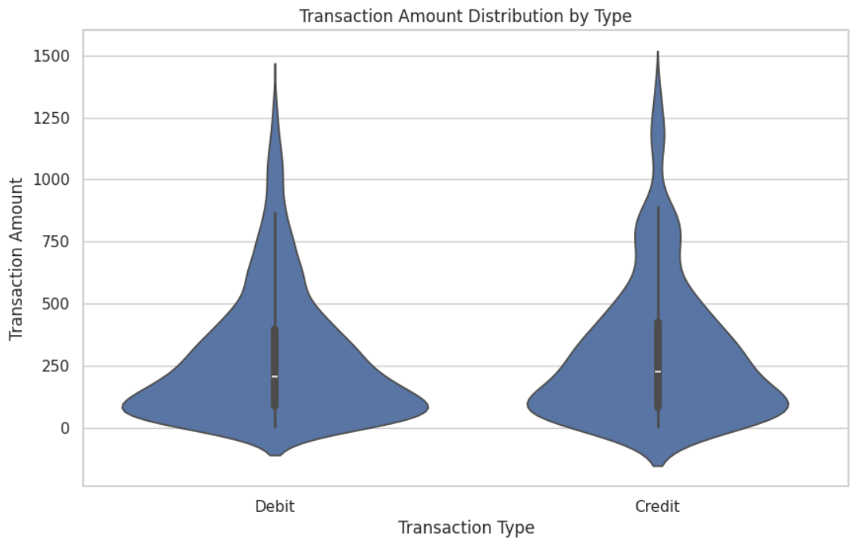
Violin Plot:
Combines boxplot and kernel density estimation to show the distribution of transaction amounts for each transaction type.

Slide 10
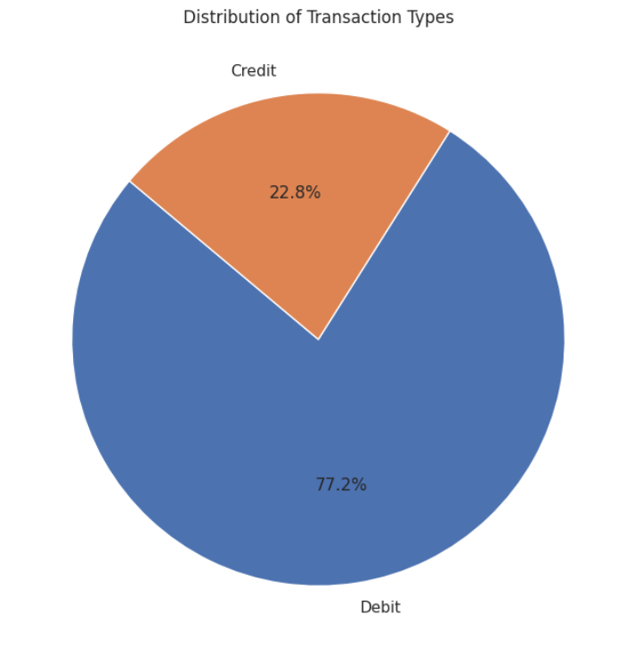
Pie Charts:
Explores the proportion of transaction types and top categories like locations and merchants.

Slide 11
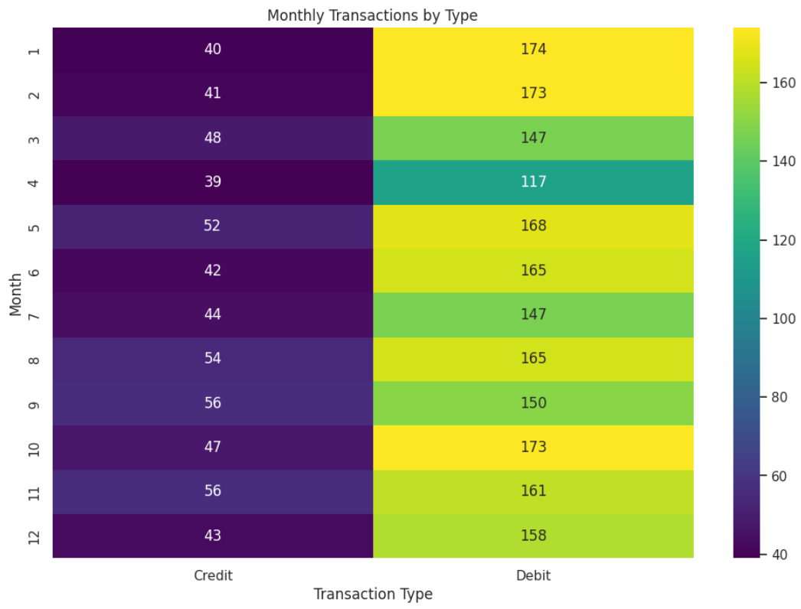
Heatmap:
Visualizes monthly transactions by type using a pivot table for aggregated analysis.

Slide 12
High-Cost Exchanges
Analysis: The top 5% of high-value transactions are singled out and examined independently.
The transaction type is shown as a hue on the distribution of these transactions.
Insights: Enables the identification of transactions that are exceptionally large or prone to fraud.

Slide 13
Feature Engineering
A fresh feature Time-series analysis and monthly aggregation are made possible by creating Month from the TransactionDate column.

Slide 14
Pipeline for Machine Learning
Goal Variables: TransactionType (Debit or Credit) is the target for classification. TransactionAmount is the target for regression. Actions to take: Train-Test Division: To assess model performance, the data is divided into 80% training and 20% testing sets. Preparation: Numerical Features: Consistent scaling through standardization with StandardScaler. Categorical features are transformed into a machine-readable format by one-hot encoding them with OneHotEncoder. Models Employed: .

Slide 15
For jobs involving classification, use logistic regression. Decision Tree: Facilitates both regression and classification. Random Forest: An ensemble model for reliable regression or classification. For regression jobs specifically, use linear regression.
Pipelines: Preprocessing and modeling procedures are combined to create each model. This guarantees seamless model training and data transformation

Slide 16
Model Evaluation
Classification:
Accuracy: The percentage of accurate forecasts.
Each class's precision, recall, F1-score, and support are included in the classification report.
Confusion Matrix: Shows how well the classification models function.
Regression:
The average squared discrepancies between expected and actual values are measured by the mean squared error, or MSE.
Feature Importance: Draws attention to the Random Forest-specific attributes that have the most influence on the model.

Slide 17
Insights and Visualizations
Comparing Models
To compare the performance of the Random Forest, Decision Tree, and Logistic Regression models, model accuracies are presented in a bar chart. The significance of features.
The top ten features for Random Forest are displayed, making it easier to understand the model and pinpoint the main factors influencing transaction predictions.
Analysis of Channels and Transaction Types: examines how different transaction types and channels (such as internet, ATM, etc.) differ, offering insightful information about consumer behaviour and channel usage.

Slide 18
Recommendations for Enhancing Hyperparameter Adjustment:
To maximize model parameters, apply strategies such as grid search or random search.
Managing Absent Information: Use more sophisticated imputation methods (such as regression-based imputation or KNN Imputer) in place of forward-filling.
Engineering Features: Include other features such as the number of transactions, average transaction value, or days since the previous transaction.
Fraud Identification: Examine classification models for the express purpose of identifying questionable or high-value transactions in order to identify fraudulent ones.

Slide 19
Conclusion
The code offers a comprehensive pipeline for analysing data from bank transactions.
Trends and insights are shown through EDA and visualizations.
Machine learning models perform well in predicting the kinds or amounts of transactions.
It turns out that Random Forest is a powerful model for determining the significance of features and producing precise forecasts.Because it is modular, this platform may be expanded for additional research, including consumer segmentation and fraud detection.

Slide 20
Thank You

